Slide 1
Manufacturing Technology
25/01/2018
(ME461)
Instructor: Shantanu Bhattacharya

Slide 2
Review of previous lecture
CAD/CAM data exchange. IGES, PDES and DXF modes of data exchange.
Direct and indirect translation strategies.
Summary of basic manufacturing processes. (Turning, Drilling, Milling and Grinding operations)
Computer aided process planning (definition).
Steps in CAPP.

Slide 3
Computer Aided Process Planning
Process planning serves as an integration link between design and manufacturing and is very important for designing a process.
In this topic we will be looking at steps to develop a process plan, computer aided process planning (both variant and generative approaches), Knowledge based process planning and feature recognition approaches.

Slide 4
Overview of manufacturing processes
Here we review some basic manufacturing processes like turning, drilling, milling, and grinding. Some other manufacturing processes can be other than cutting processes like forming, production of electronic circuit boards, soldering etc.
Turning operations:
Turning is a common and a versatile machining process for producing cylindrical, conical, or irregularly shaped internal or external surfaces on a rotating work piece.
The machine tool used is the lathe.
Typical parts include pins, shafts, spindles, handles, and various other components having O-ring grooves, holes, threads (both external and internal), and many other shapes.
Cutting operations can b performed on a lathe include straight turning, taper turning, profiling, turning and external grooving, facing, face grooving, drilling, boring and internal grooving, cutting off, threading and knurling as shown in the next figure.

Slide 5
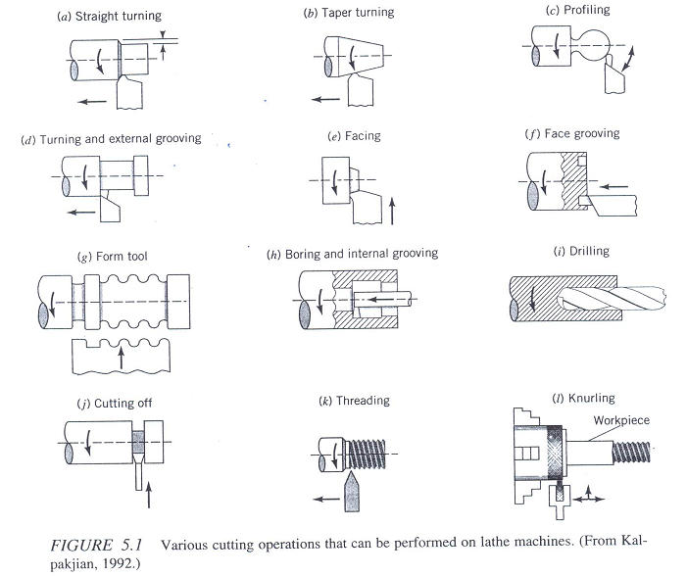
Various cutting operations performed on Lathe machines

Slide 6
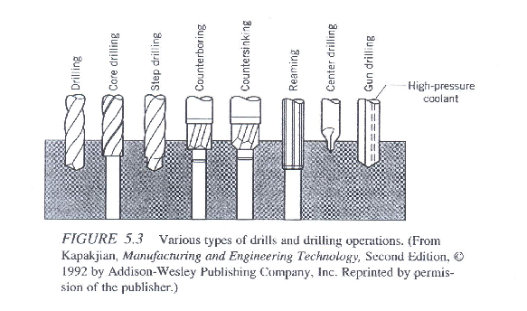
Overview of manufacturing processes
Drilling operations:
Drilling is another common machining operation for producing through holes or blind holes.
For example assembly processes involving fasteners such as rivets, screws, and bolts require holes.
To perform the drilling operations, a cylindrical rotary end cutting tool called a drill is employed.
Different types of drills and drilling operations are used as shown below.

Slide 7
Overview of manufacturing processes
Other operations that involve hole making include boring, counter-boring, spot facing, countersinking, reaming, and tapping.
Boring: Involves enlarging an already drilled hole.
Counter-boring: Only one end of the drilled hole is enlarged.
Spot facing: Finishing off a small surface area around the opening of a hole.
Countersinking: It is similar to counter-boring except that the hole enlarged at one end is conical (tapered). The idea is to accommodate the conical seat of a flathead screw inside.
Reaming: Reaming is a sizing process used to make an already drilled hole dimensionally more accurate and to provide a very smooth surface.
Tapping: It is the process of producing internal threads in work-pieces by using a threaded tool with multiple cutting teeth; the tool is called a tap.

Slide 8
Overview of manufacturing processes
Milling operations:
Milling is used to produce a variety of shapes such as flat, contoured, and helical surfaces.
It is used for thread and gear cutting operations, among others.
The milling process involves simultaneous rotary motion of milling cutter and linear motion of work piece.
Based on the direction of cutter rotation and work piece feed the milling process is classified into upmilling and down milling based on different or similar direction of the cutter rotation with respect to the work-piece motion.
A large variety of milling cutters are used to produce different shapes for example, plain milling cutters are used to produce flat surfaces; side milling cutters for cutting slots, grooves and spines; T-slot cutter for milling T-slots; and form milling cutters for milling gears and other concave and convex shapes.

Slide 9
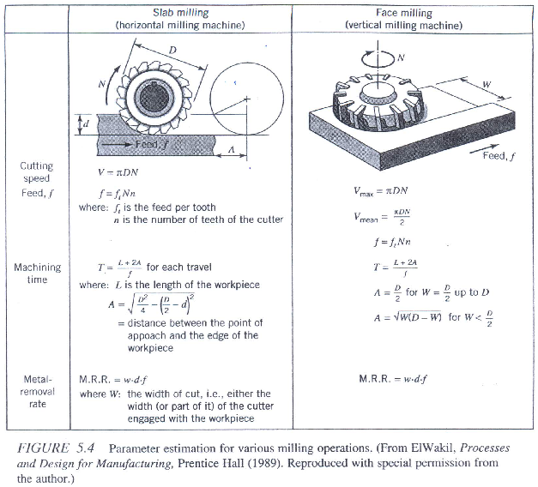
Methods of estimating parameters for various milling operations

Slide 10
Overview of manufacturing processes
Grinding Operations:
In grinding, material removal is achieved by employing a rotating abrasive wheel. In fact, grinding is quire similar to milling except that abrasive wheels are used in place of milling cutters.
Grinding is generally used to obtain the finest dimensional accuracy and surface finish in manufactured products.
Common grinding operations include surface grinding, cylindrical grinding, internal grinding, and centerless grinding.
For estimating the various parameters of surface grinding for both horizontal and vertical grinding cases are given in the next figure

Slide 11
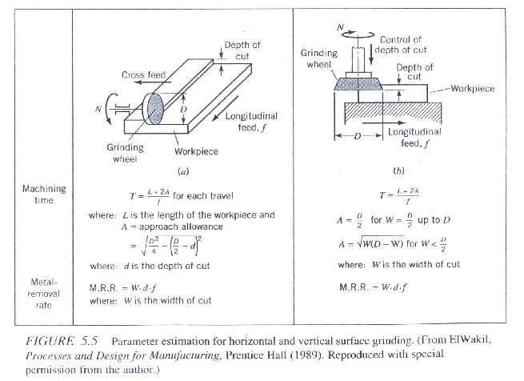
Parameter estimation of horizontal and vertical surface grinding

Slide 12
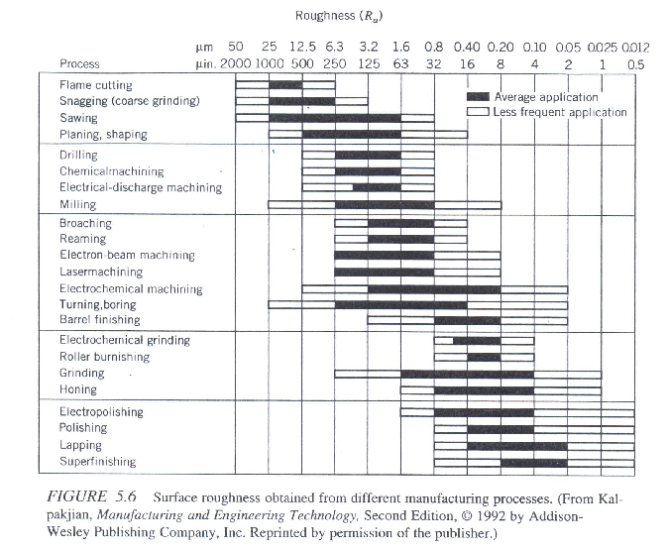
Surface roughness obtained from different manufacturing processes

Slide 13
What is process planning?
Products and their components are designed to perform certain functions.
The design specifications ensure the functionality aspects.
In manufacturing the task is to produce components that meet design specifications.
The components are then assembled into final products.
Process planning acts as a bridge between the design and manufacturing by translating design specifications into manufacturing process details.
Process planning therefore refers to a set of instructions that are used to make a component or a part that meets up with the design specifications.
The question is what information is required and what activities are involved in transforming a raw part into a finished component, starting with the selection of raw material and ending with the completion of the part.
The following basic steps are involved in developing a process plan.

Slide 14
Basic steps in developing a process plan
This involves a no. of activities like:
Analysis of part requirements.
Selection of raw work piece.
Determining manufacturing operations and their sequences.
Selection of machine tools.
Selection of tools, work holding devices, and inspection equipments.
Determining machining conditions (cutting speed, feed and depth of cut) and manufacturing times (setup time, processing time, and lead time).

Slide 15
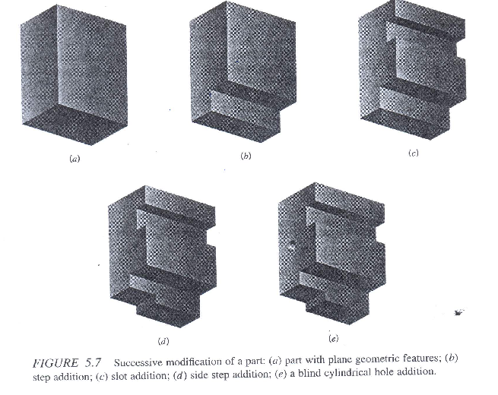
Analysis of part requirement
The primary purpose of process planning is to translate the design requirements for parts into manufacturing process details.
At the engineering design level, the part requirements can be defined as the part features, dimensions, and tolerance specifications which in turn determine the processing requirements.
For example consider the part given in figure (a) with plain geometric feature.
The part is successively modified by a step (b).
A slot (c).
A side step (d).
A blind cylindrical hole (e)

Slide 16
Selection of raw work-piece
The selection of raw workpeice is an important element of process planning.
It involves such attributes as shape, size (dimensions and weight), and material.
For-example a raw part may be in the shape of a rod, a slab, a blank, or just a rough forging.
From the point of view of dimensional accuracy as well as economics of manufacturing, it is important to determine the required oversize of the raw part.
The weight a material of the raw part are dictated by functional requirement of the parts.

Slide 17
Determining Manufacturing Operations and their sequences.
The next logical step in process planning is to determine the appropriate types of processing operations and their sequence to transform the features, dimensions, and tolerances of a part from the raw to finished state.
There may be several ways to produce a given design. Sometimes constraints such as accessibility and setup may require that some features be machined before or after others.
Furthermore, the types of machines and tools avialable as well as the batch sizes influence the process sequence.
For-example, a process plan that is optimal on a three or four axis machine may not be optimal on a five axis machine because of the greater flexibility of higher axis machines.
Surface roughness and tolerance requirements also influence the operation sequence. For example, a part requiring a hole with low tolerance and surface roughness specifications would require a simple drilling operation. The same part with much finer surface finish and closer tolerance requirements would require first a drilling operation and then a boring operation to obtain the desired surface roughness and the tolerance on the hole feature of the part.

Slide 18
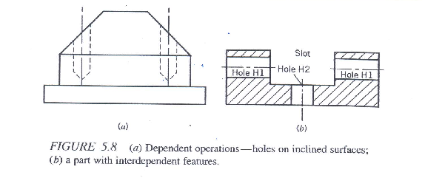
Determining Manufacturing Operations and their sequences.
Sometimes operations are dependent on one another. For example, consider figure (a), in which the operations on the part show the following dependence:
The holes must be drilled before milling the inclined surface because the holes cannot be drilled accurately on an inclined surface.
However, if the inclined surface has to be finished before drilling, an end mill should be used to obtain a flat surface perpendicular to the axis of the drill before drilling the hole.
3. Cutting forces and rigidity of the workpiece may also influence the operation sequence.
4. In (b) hole H2 must be produced before machining the slot . If the hole is machined after finishing the slot, it may bend.

Slide 19
Selection of machine tools
The next step in process planning after the selection of manufacturing operations and their sequence is to select the machine tools on which these operations can be performed.
A large number of factors influence the selection of machine tools.
Work piece related attributes such as the kinds of features desired, the dimensions of the work piece, its dimensional tolerance, and the raw material form.
Machine tool related attributes such as process capability, size, mode of operation (e.g., manual, semiautomatic, automatic, numerically controlled etc.), tooling capabilities (e.g., size and type of tool magazine), and automatic tool changing capabilities.
Production volume related information such as the production quantity and order frequency.

Slide 20
Selection of tools, work holding devices, and inspection equipment
A combination of machine tool and cutting tool is required to generate a feature on the work piece.
Work-holding devices are used to locate and hold the work pieces to help generate the features.
Inspection equipment is necessary to ensure the dimensional accuracy, tolerances, and surface finish on the features.
The major categories include online and off-line inspection equipment.
The selection of machine tools, cutting tools, fixtures, and inspection equipment is based primarily on part features. For example if tolerances are to be specified in the range of + 0.0002 to + 0.0005 in./in. and surface finishes in the range of 16 and 32 µin., then the Swiss Automatics as a machine tool and a high speed steel (HSS) single point cutting tool may be recommended.
Furthermore, cutting tool specifications may include various angles such as rakes, clearances, cutting edge, and nose radius.

Slide 21
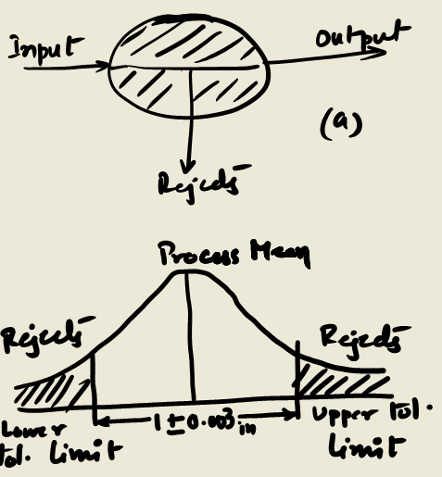
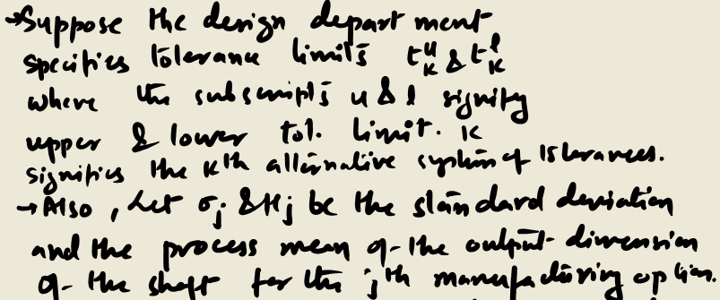
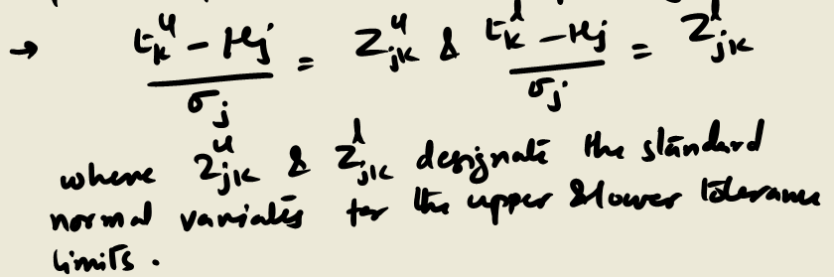
Mathematical Model for understanding interactions between design and manufacturing in a turning process of a cylindrical shaft
We consider a simple product, a cylindrical shaft.
The design stage is concerned with specifying tolerances on the shaft.
The manufacturing stage is essentially a transformation process, changing a bar stock into a finished shaft meeting tolerance specification.
The transformation process indicating inputs and outputs is shown in (a) and the unit normal curve indicating tolerances and the fraction rejects in (b)

